Slide 1

Regular Expressions
ASCII , UTF-8

Slide 2
Character types
Char
String
StringBuilder
ASCII, UTF-8

Slide 3
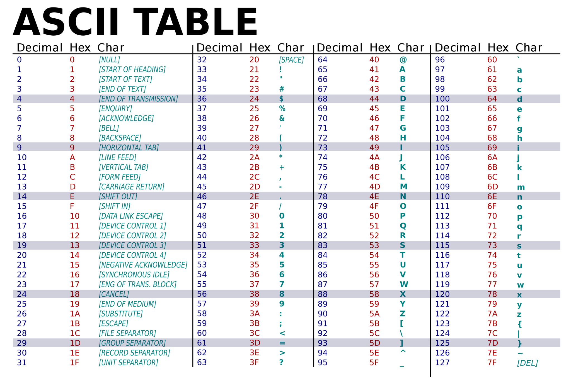

Slide 4
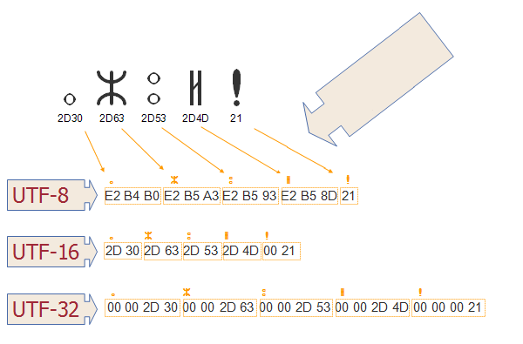

Slide 5
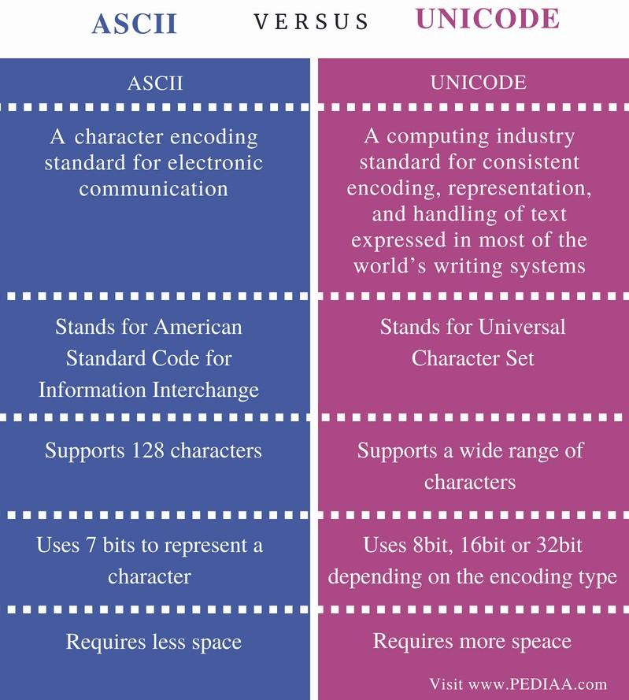

Slide 6
Regular expressions
Character classes
Quantifiers
Metacharacters
Validation practices
Notes:
regex101.com

Slide 7
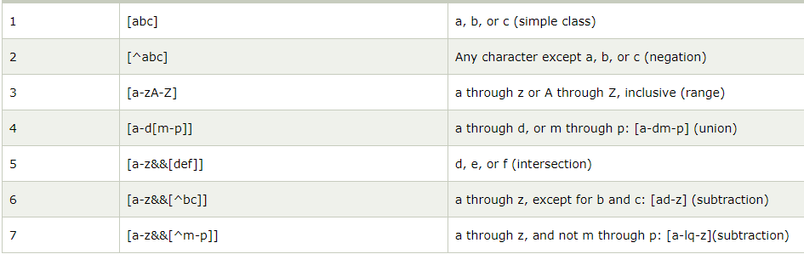
Regex Character classes

Slide 8
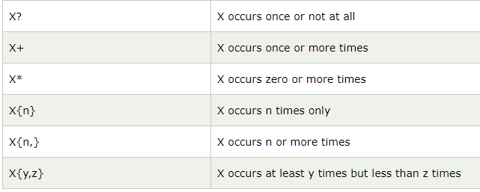
Regex Quantifiers

Slide 9
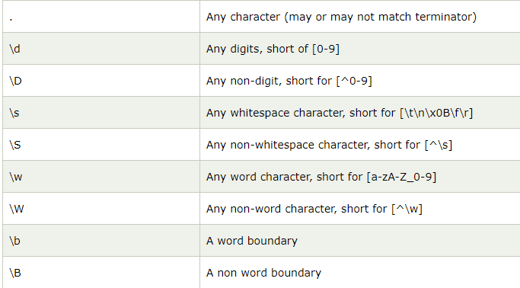
Regex Metacharacters

